Slide 1
Percentages Revision
EQ – Describe the methods for solving problems with percentage increase and decrease.
Lesson Objectives – To be able to solve worded problems involving percentage increase/decrease.

Slide 2
Answer the following –Showing the steps of your working on white boards
James scored 23 out of 40 in a test. Write this as a percentage.
A dress costing $60 was on sale in shop discounted to $51. What is the percentage discount?
Find 13% of $140
Increase $450 by 45%

Slide 3
Interactive Notebook
Your name
Class App 11
Teachers Name – Mrs Rust
Semester 1 Term 1

Slide 4
Contents
Glossary or Formula Page
Page
Date
Description
2
3

Slide 5
Tasks
24
7
30
Essential Question
Questions
Notes
Summary
4
5

Slide 6
24
7
30
2nd Feb 2018
Percentages Revision
EQ- Describe the methods for solving problems with percentage increase and decrease.
Writing as a percentage
5

Slide 7
24
7
30
2nd Feb 2018
Percentages Revision
EQ- Describe the methods for solving problems with percentage increase and decrease.
Writing as a percentage
- Write as a fraction and multiply by 100
5

Slide 8
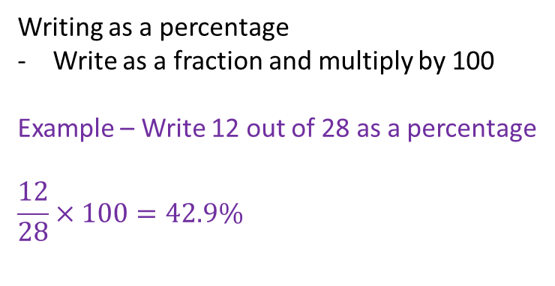
24
7
30
2nd Feb 2018
Percentages Revision
EQ- Describe the methods for solving problems with percentage increase and decrease.
Writing as a percentage
Write as a fraction and multiply by 100
Example – Write 12 out of 28 as a percentage
$$\frac{12}{28}×100=42.9\%$$
5

Slide 9
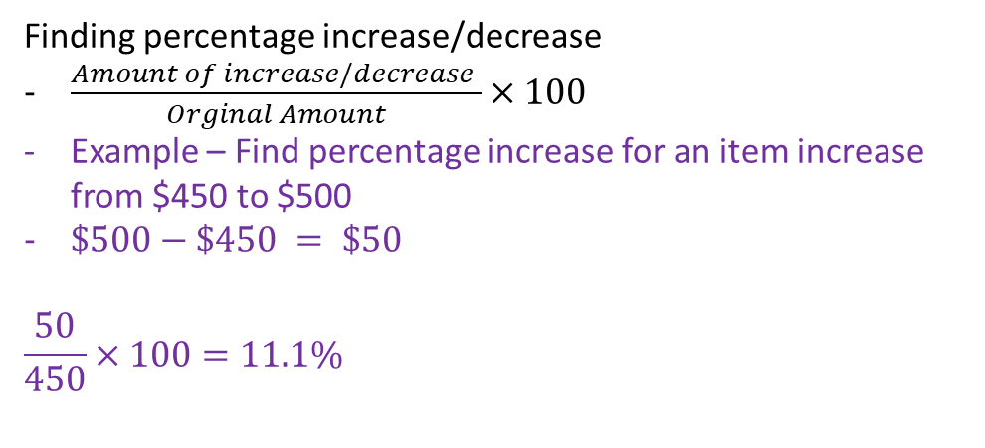
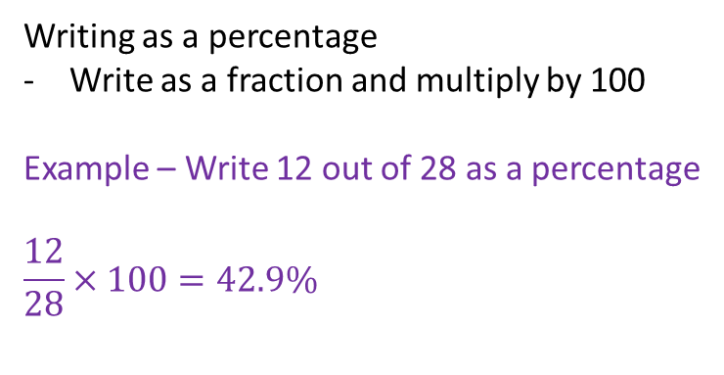
24
7
30
2nd Feb 2018
Percentages Revision
EQ- Describe the methods for solving problems with percentage increase and decrease.
Writing as a percentage
Write as a fraction and multiply by 100
Example – Write 12 out of 28 as a percentage
$$\frac{12}{28}×100=42.9\%$$
Finding percentage increase/decrease
$\frac{Amount of increase/decrease }{Orginal Amount}×100$
Example – Find percentage increase for an item increase from $450 to $500
$\$500−\$450 = \$50$
$$\frac{50}{450}×100=11.1\%$$
5

Slide 10
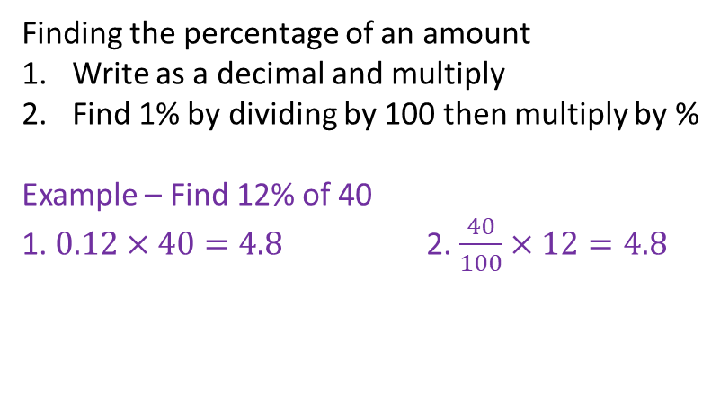
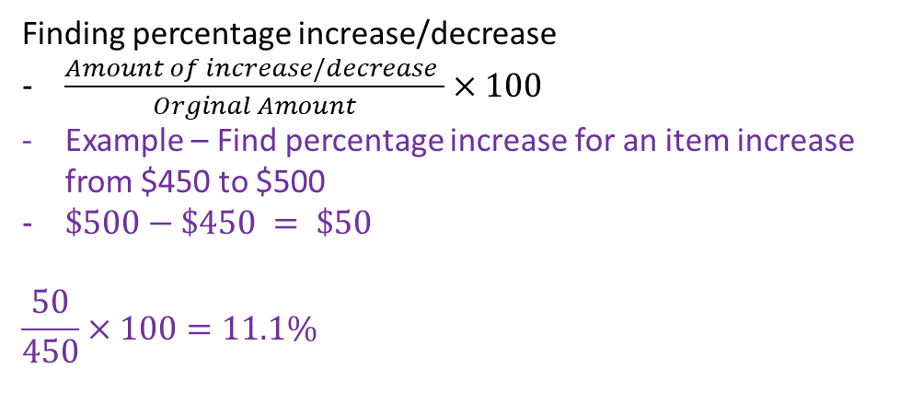
24
7
30
2nd Feb 2018
Percentages Revision
EQ- Describe the methods for solving problems with percentage increase and decrease.
Finding percentage increase/decrease
$\frac{Amount of increase/decrease }{Orginal Amount}×100$
Example – Find percentage increase for an item increase from $450 to $500
$\$500−\$450 = \$50$
$$\frac{50}{450}×100=11.1\%$$
Finding the percentage of an amount
Write as a decimal and multiply
Find 1% by dividing by 100 then multiply by %
Example – Find 12% of 40
1. $0.12×40=4.8$ 2. $\frac{40}{100}×12=4.8$
5

Slide 11
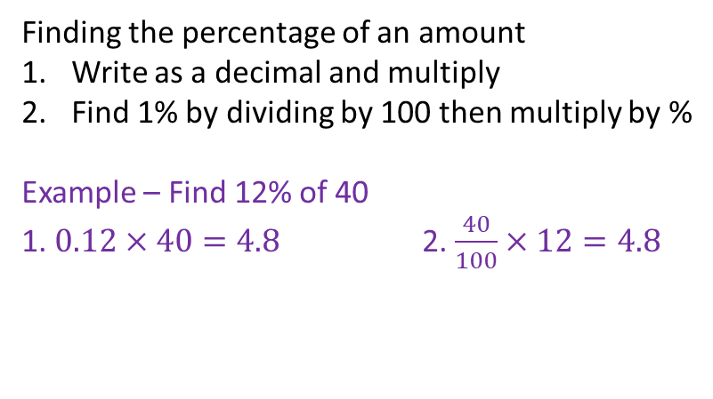
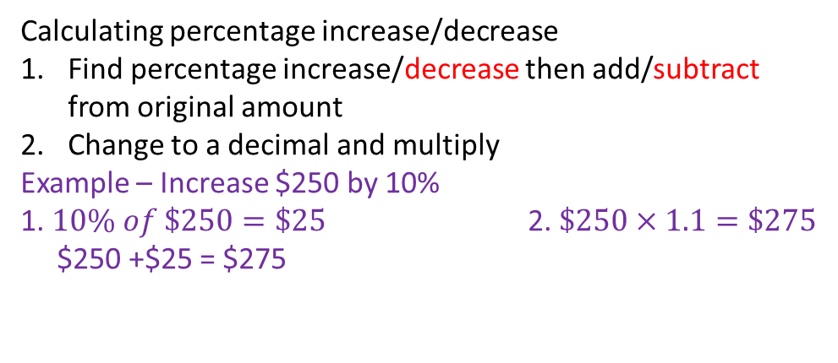
24
7
30
2nd Feb 2018
Percentages Revision
EQ- Describe the methods for solving problems with percentage increase and decrease.
Finding the percentage of an amount
Write as a decimal and multiply
Find 1% by dividing by 100 then multiply by %
Example – Find 12% of 40
1. $0.12×40=4.8$ 2. $\frac{40}{100}×12=4.8$
Calculating percentage increase/decrease
Find percentage increase/decrease then add/subtract from original amount
Change to a decimal and multiply
Example – Increase $250 by 10%
1. $10\% of \$250=\$25$ 2. $\$250×1.1=\$275$
$250 +$25 = $275
5

Slide 12
Questions
Sadler Exercise 2A

Slide 13
Notes Review
24, 7 ,30
Date
Title
Essential question
Notes complete
Notes complete with colour and diagrams
Questions completed
Contents page filed in
Formula page filled in

Slide 14
Homework
Naplan Practice
Review your notes and write a summary answering the essential question.

